Slide 1
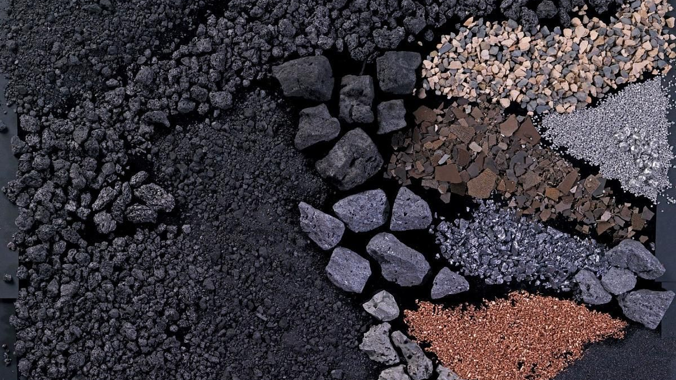
CaCeRMDI’s Presentation on Two Saskatchewan’s Raw Materials-Potash and Uranium
Presented by: Leo Ekhaguere
President, CaCeRMDI

Slide 2
Table of Content
1. Definition of Raw Materials
2. Types of Raw Materials
3. Mineral-Based Raw Materials
4. Facts about Potash and Uranium in Saskatchewan
5. Agricultural-Based Raw Materials
6.. Fossil Fuels

Slide 3
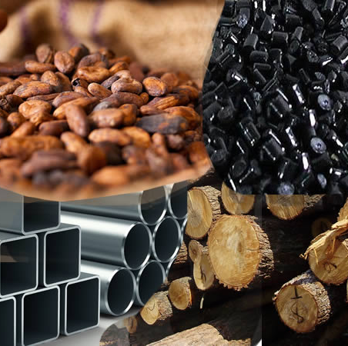
What are Raw Materials?

Slide 4
Raw materials coined from “Raw” and “Materials”
Raw- Unprocessed (In its natural state or form)
Materials- Resource or Substance
Cotton, Minerals Ores, latex, Wood, Crude
Useful Substance
Processing
CACERMDI’S DEFINITION: A Raw material is any unprocessed natural resource or substance modified to produce another resource or substance.

Slide 5
Types of Raw Materials
Mineral-Based Raw Materials
Agro-allied or Agricultural Raw- Materials
Fossil Fuels

Slide 6
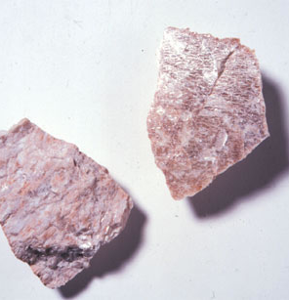
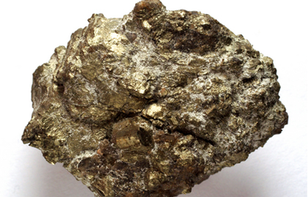
Mineral-Based Raw Materials
Naturally Occurring
Homogenous
Definite Chemical Composition
Formed Inorganically

Slide 7
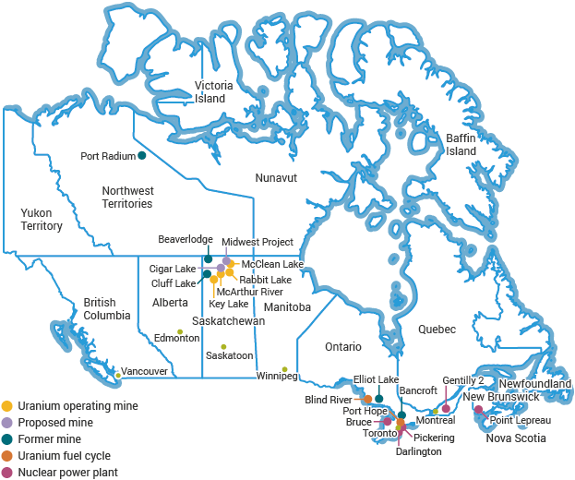
Facts about Potash and Uranium in Saskatchewan
Saskatchewan has two of the most desirable minerals in the world-Potash and Uranium
The Worlds Largest high grade Uranium deposits are located in Northern Saskatchewan- McArthur River Uranium Mine

Slide 8
Saskatchewan is the world’s leading supplier of Uranium. 90% is exported; 10% used in fueling nuclear reactors in Canada.
Saskatchewan’s Uranium is responsible for powering approximately 1 in 20 homes in the US.
There is also significant unrealized potential for volcanogenic and sediment-hosted base metal deposits in supracrustal rocks of Precambrian Shield of northern Saskatchewan

Slide 9
Source: Satistica.com

Slide 10
There are areas with high gold potential that remains under-explored.
Other mineral based resources produced in Saskatchewan are Salt and Kaolin, Sodium and Potassium Sulphates, and potentials of Copper, Zinc, Nickel, Cobalt, Rare earth and Platinum group elements.
Saskatchewan has the largest potash industry in the world, accounting for about one-third of global annual production.

Slide 11
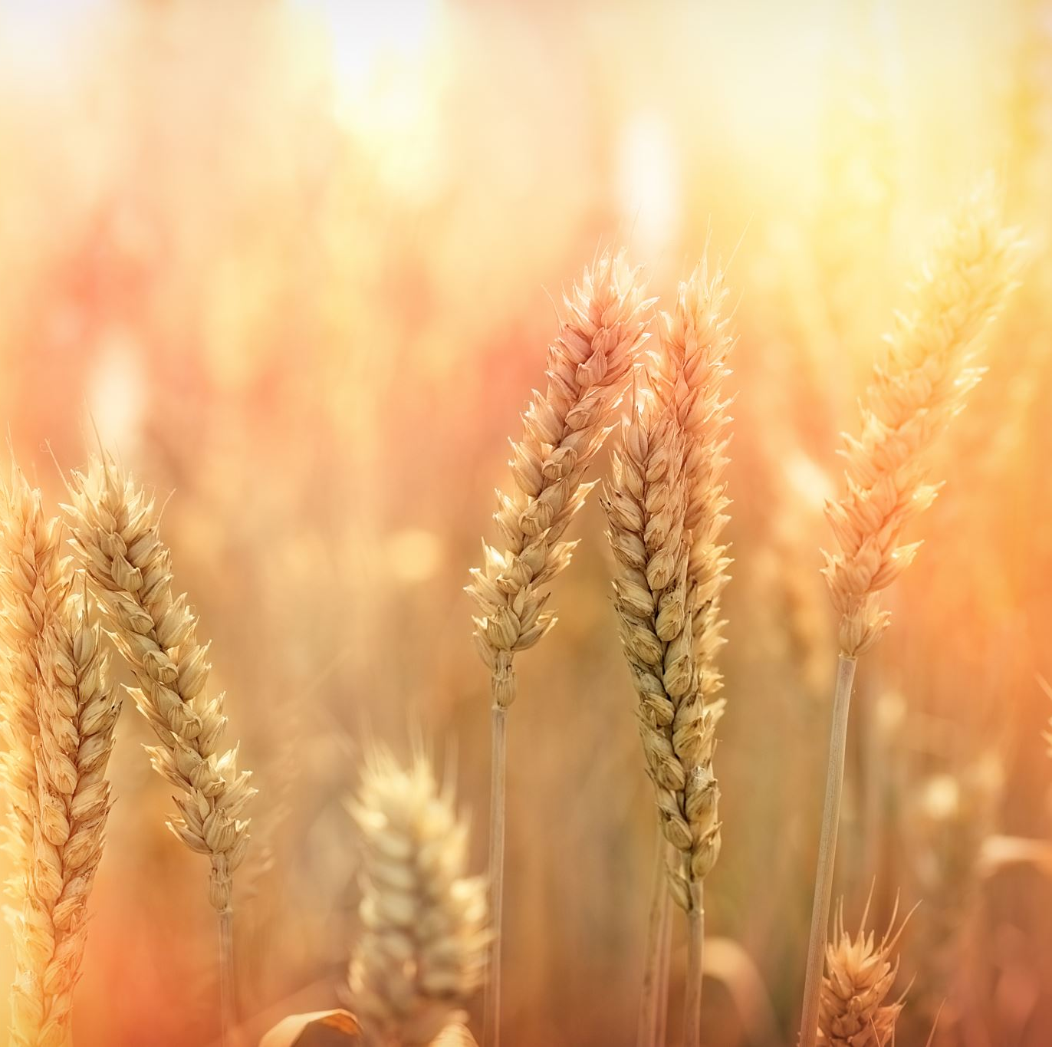
Agricultural Raw-Materials
Crops grown
Animals reared
For provision of food, wool and other products

Slide 12
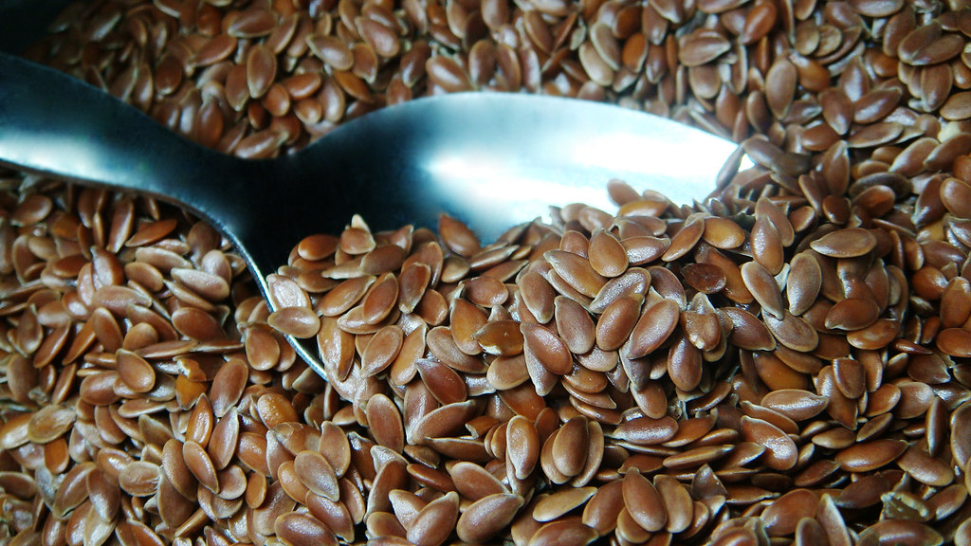
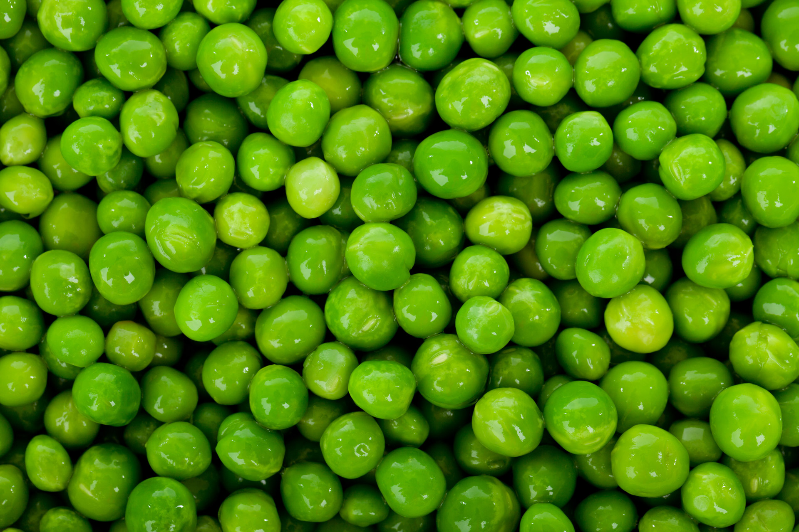
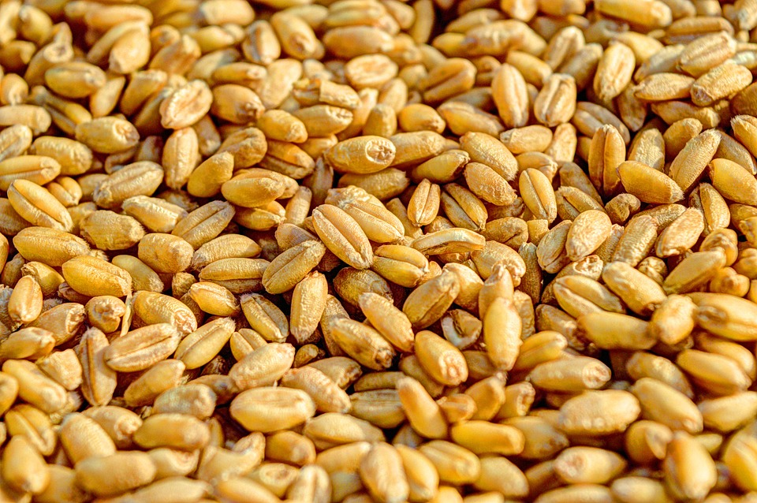
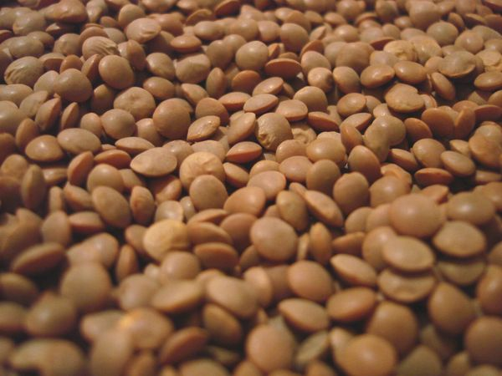
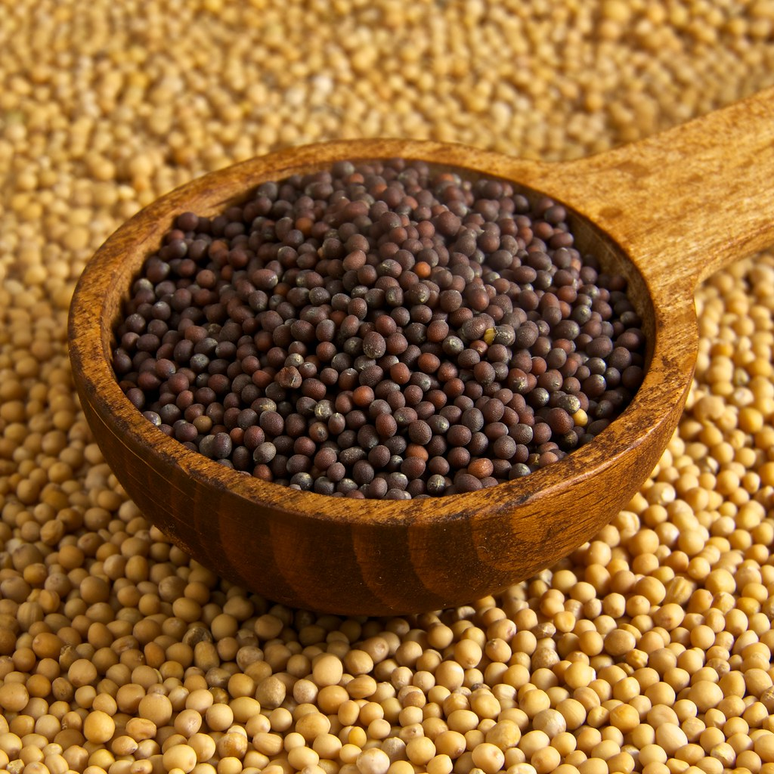
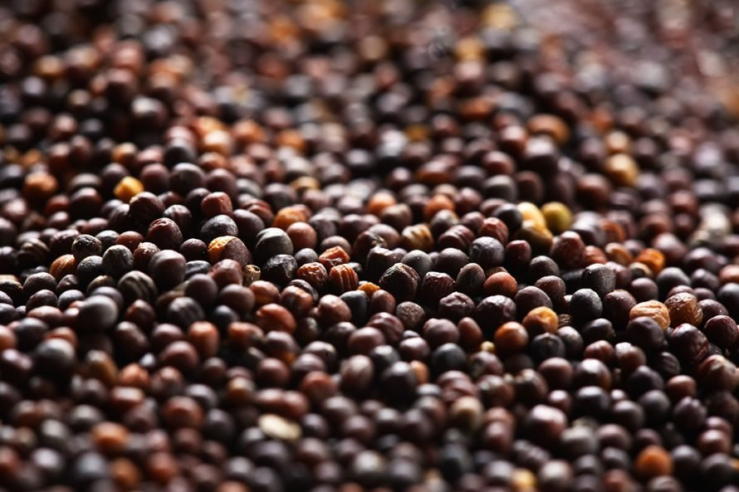
Saskatchewan is the world’s largest exporter of lentils, peas, durum wheat, mustard seed, canola, flaxseed and oats.
Saskatchewan is the second largest cattle-producing province in Canada

Slide 13
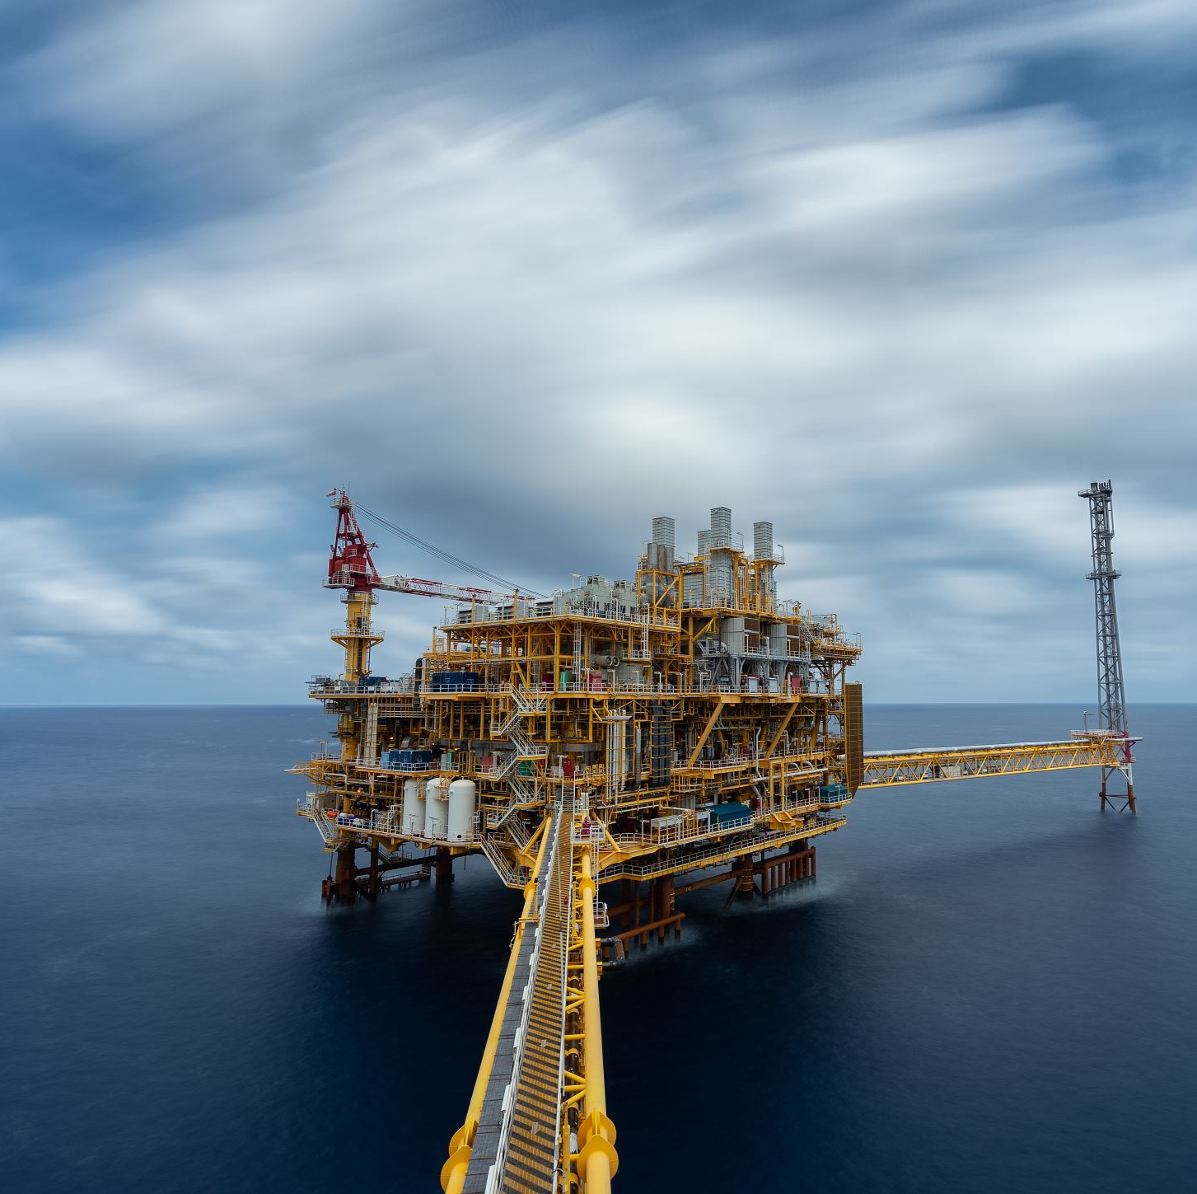
Fossil Fuels
Raw materials from:
Decomposing plants
Decomposing Animals
E.g. Coal, Crude Oil, Natural gas

Slide 14
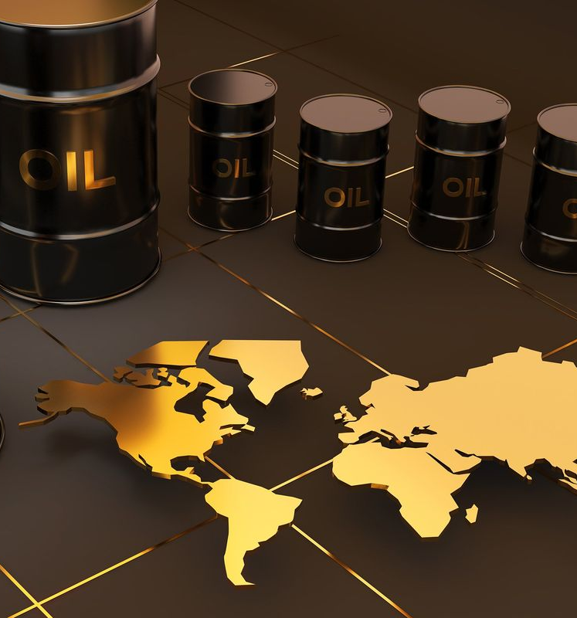
Saskatchewan is the second-largest oil producer in Canada and the sixth-largest onshore producer in Canada and the United States.
Saskatchewan is the third largest Natural gas producer in Canada

Slide 15
Saskatchewan has an estimated oil reserve of almost 1.2 billion barrels.
Saskatchewan’s expertise in clean coal technologies is an example of how the province is committed to greening up its conventional energy resources..

Slide 16
From the bottom of the mine to the top of the silo, nutrien is continuously committed to feeding the future safely and with integrity each day, leading the agriculture industry in innovation and bold new thinking because the future needs food

Slide 17
Conclusion
CaCeRMDI is committed to educating the general public on raw materials. We are focused on Potash and Uranium for this conference edition, but we have only Potash to display which was given to us at no cost by Nutrien- The largest producer of Potash and third producer of Nitrogen.
We exhibit the samples for Educational purposes, Investment Purpose, and Posterity Purpose

